Slide 1

IST 722 Group project
Aaron Talley
Courtney Zimmer-Bartels
Kathi Fox
Dane Lyons

Slide 2
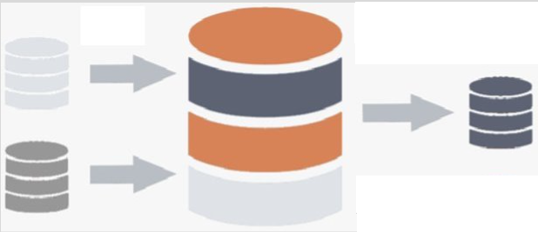
Fudgemart and Fudgeflix Integrated Data Warehouse

Slide 3
Objective
Develop a consolidated data warehouse from Fudgemart and Fudgeflix and utilize it to deliver valuable business insights regarding product and video ratings and reviews provided by customers of the two separate business concerns.

Slide 4
Business Processes – Simple
Product Inventory
Fudgemart
Fudgeflix
Sales Reporting
Fudgemart sells products online
Fudgeflix offers a tiered monthly subscription service for videos and movies
Customer Geographic Concentrations
Fudgemart provides customer address, city, state and zip
Fudgeflix provides zip only

Slide 5
Business Processes - Complex
Order Fulfillment
Fudgemart ships products to customers from online orders (similar to Amazon)
Fudgeflix delivers videos to customer via various formats (similar to Netflix)
Tracking the fulfillment process from order date to delivery date provides insight into sales growth and identifies issues with product delivery by analyzing lag times.
Customer Satisfaction Reporting
Fudgemart provides individual customer review ratings by stars
Fudgeflix provides aggregated average ratings for titles

Slide 6
Determining the Business Question(s)
What products or titles received the highest reviews?
We selected the business process of customer satisfaction reporting for integration across both Fudgemart and Fudgeflix. We will be looking at the product review stars and the movie ratings in both databases to assess which products/titles have the highest ratings amongst our customers and which genre of product our customers prefer. We will also expand on this to evaluate for quality of the combined data for recommendations.

Slide 7
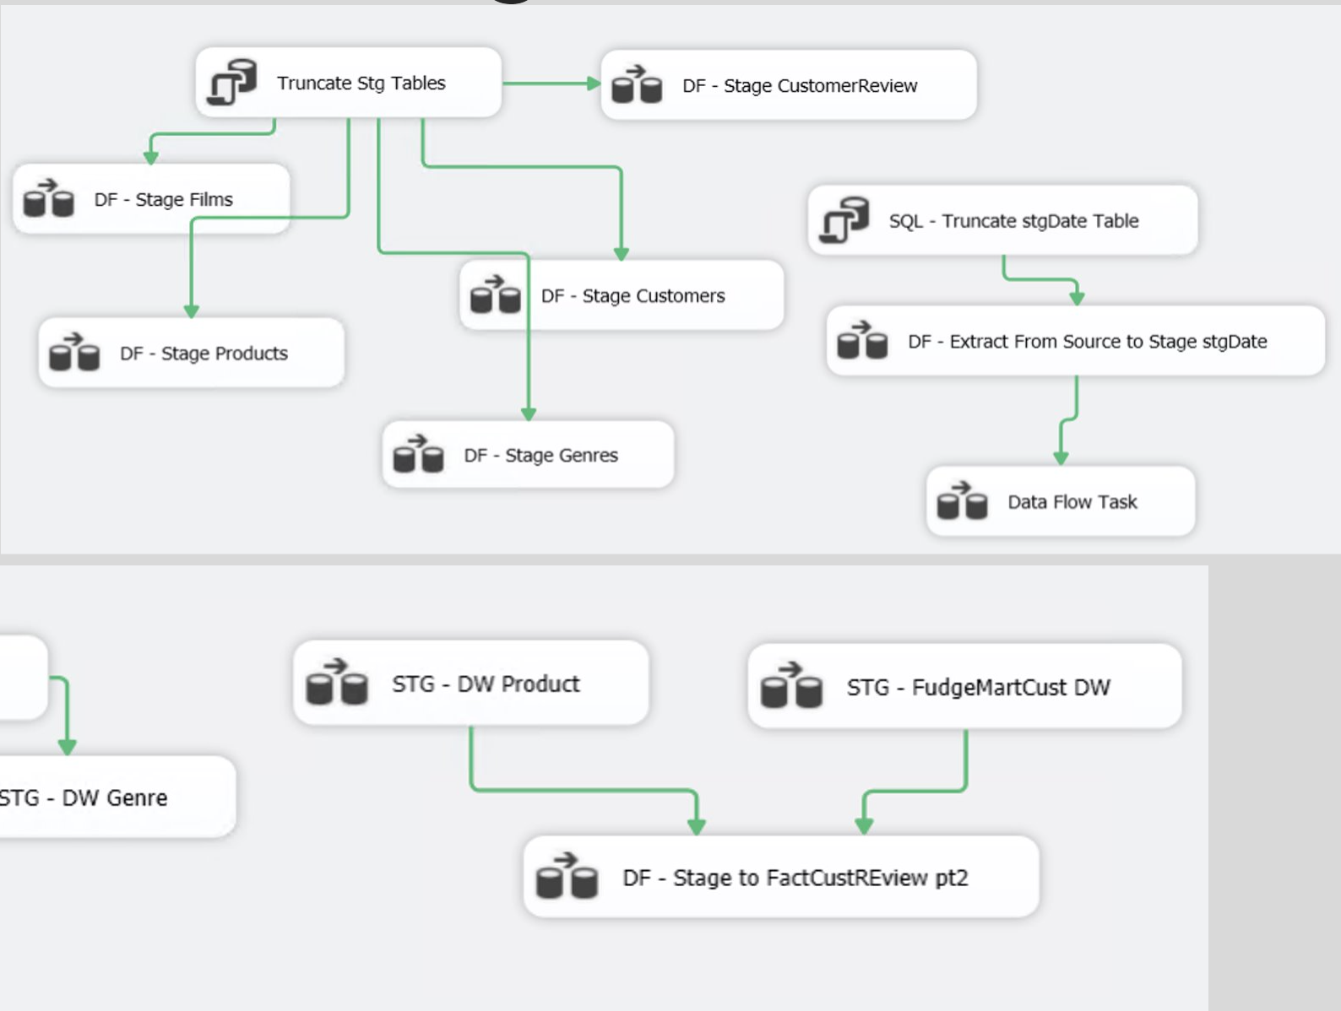
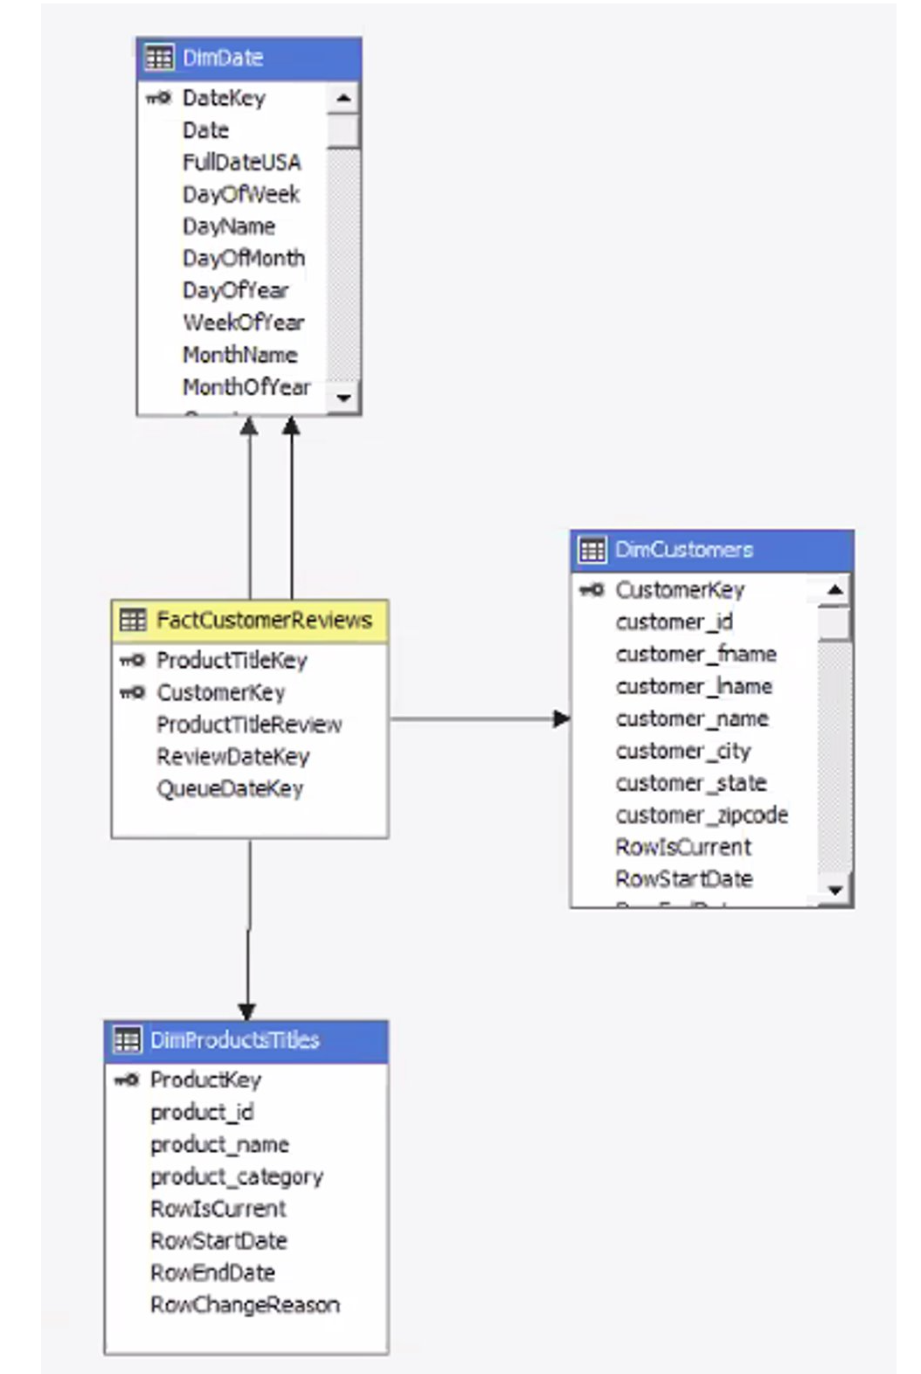
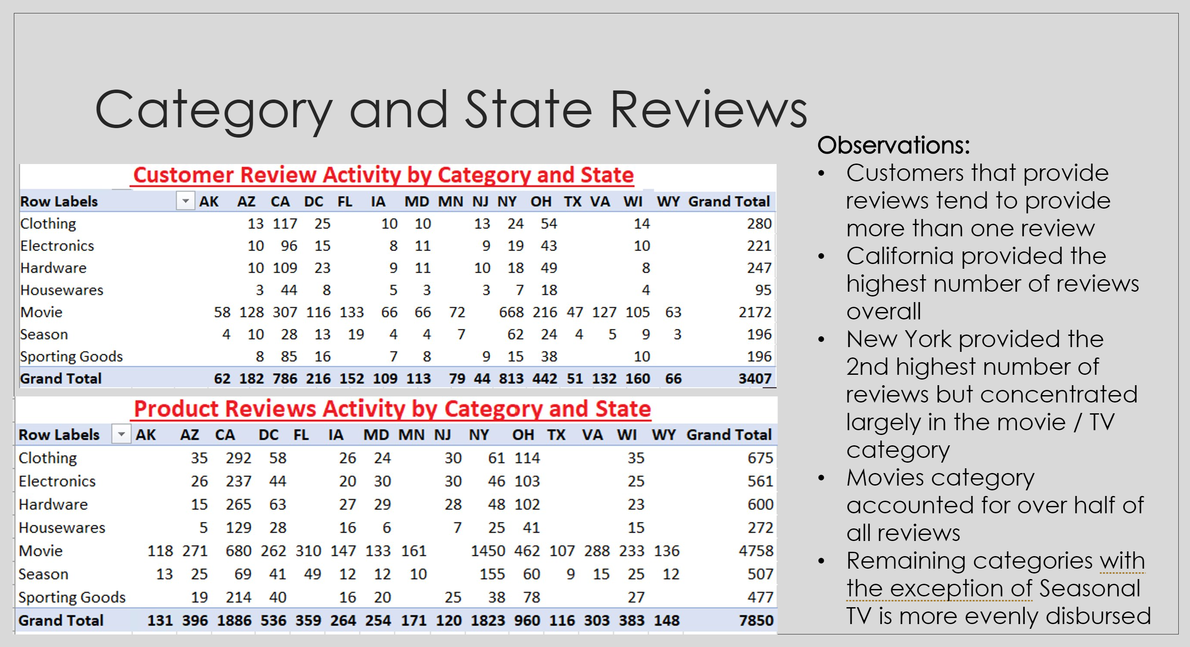
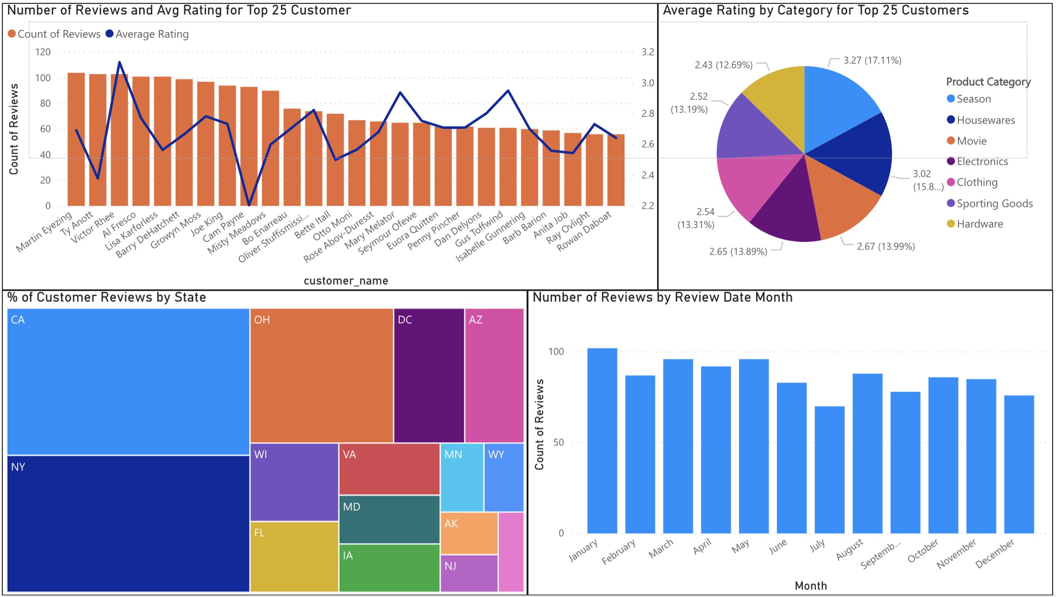
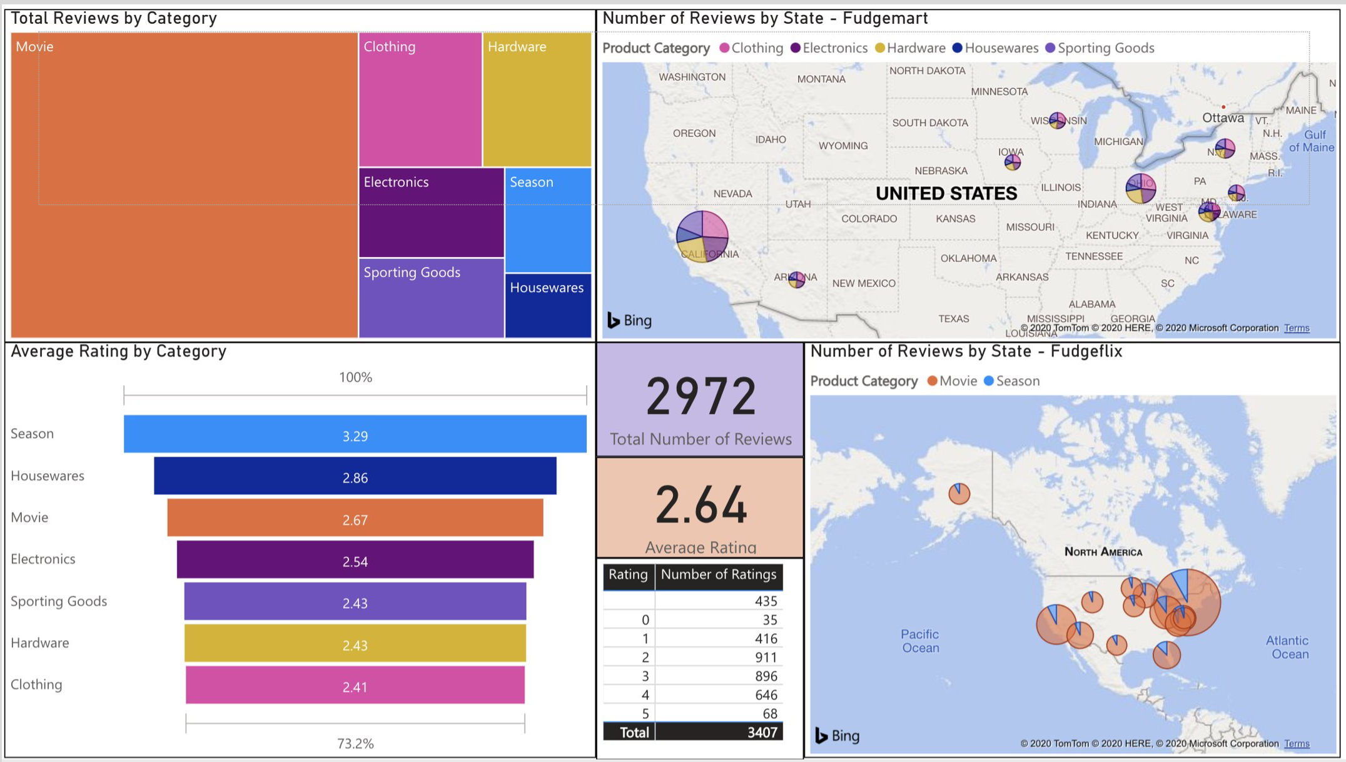
Project Overview Summary of Planned Project Milestones and Artfacts
Design and Create the Data Warehouse utilizing the Star Schema design.
Develop a Staging Environment between Source Databases and the Data Warehouse.
Generate Data Flow Processes to move and transform data from Source Databases to the Data Warehouse.
Analyze the data to gain valuable business insights towards the principle objective of the project.
Present our Findings utilizing graphical visualizations.

Slide 8
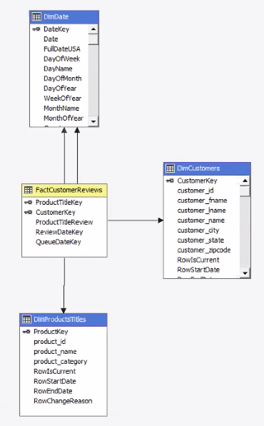
Implementation – Star Schema
Customers
ID
First Name
Last Name
Whole Name
City
State
Zip Code
ProductsTitles
ID
Product/Title Name
Description
Date
Review Update
CustomerReviews
Product/Title Key
Customer Key
ProductTitleReview (eg. Review Score)

Slide 9
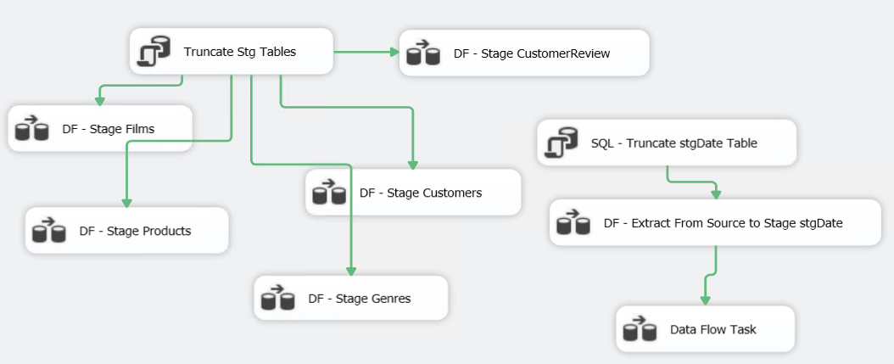
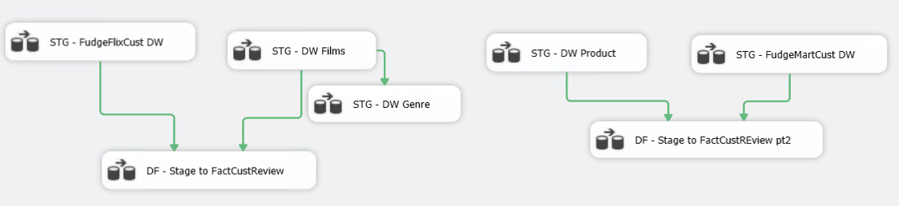
Implementation – Creating Data Warehouse

Slide 10
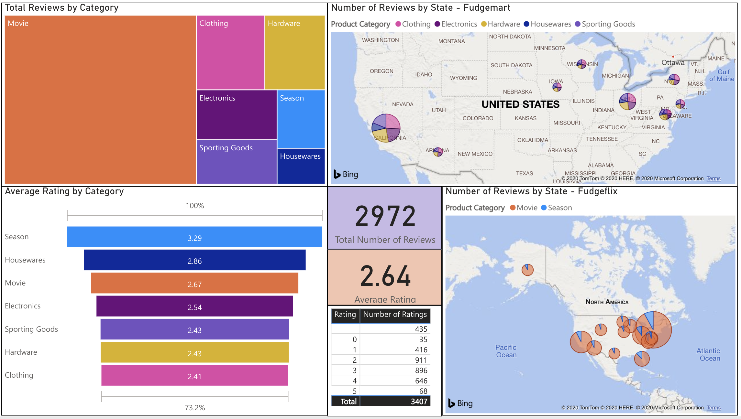

Slide 11


Slide 12
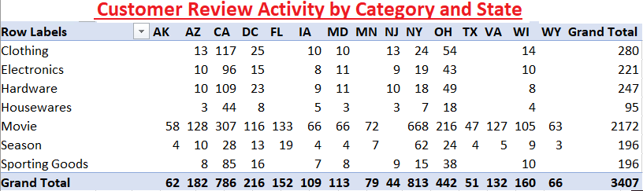
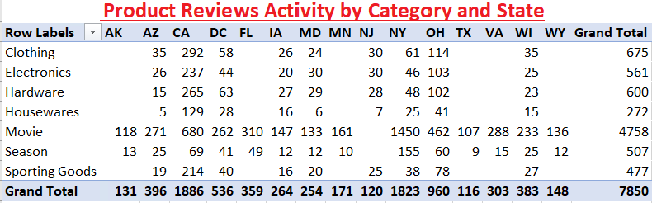
Category and State Reviews
Observations:
Customers that provide reviews tend to provide more than one review
California provided the highest number of reviews overall
New York provided the 2nd highest number of reviews but concentrated largely in the movie / TV category
Movies category accounted for over half of all reviews
Remaining categories with the exception of Seasonal TV is more evenly disbursed

Slide 13
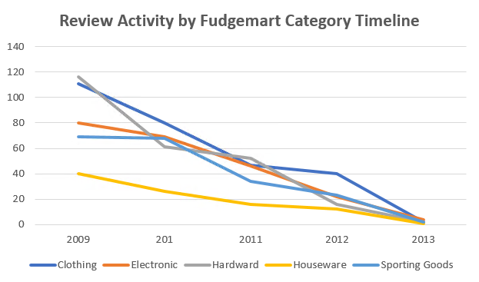
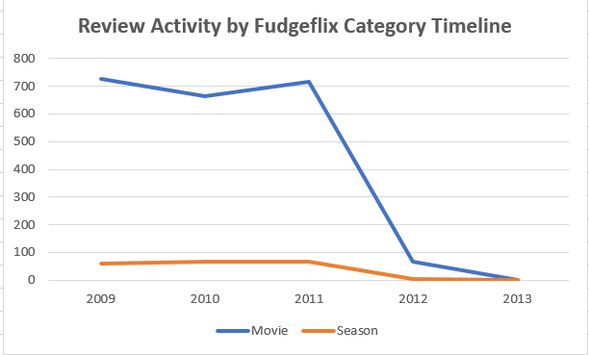
Review Timelines

Slide 14
Conclusion
Majority of engaged customers derived from Movies / Seasonal TV.
Largest concentration of engaged customers were from New York (mostly in film) while California had the largest overall participation (approximately 60% of all reviews).
Identified areas for discussion or improvements
435 no ratings derived from Fudgeflix
Florida, Arkansas, Texas, Wyoming and Virginia all had no Fudgemart reviews. These states could be areas of consumer focus in the future.
Need to constantly update to reduce null in the reviews
We'd like to have more information about why all of the reviews trended down
Lessons included:
Had difficulty with combining Fudgeflix and Fudgemart - reconciling datatypes to add genre
Queue Date and Review Date don't overlap - addressed with the dimension. Defaulted to -1
Power BI calculation issues- summing ProductTitleReview was aggregating.

Slide 15
Questions?

